Slide 1
South Carolina State Library
Acquisition of State Agency Publications
Sheila Dorsey - South Carolina State Library
Annual Training Session
December 17, 2020

Slide 2
Located at 1500 Senate Street, Columbia, SC 29201 Information Desk Email: reference@statelibrary.sc.gov Information Desk Phone: 803-734-8026

Slide 3
SC State Library Services
Research assistance
Borrowing privileges and access to Electronic Resources
SCLENDS consortium
Grants research assistance (through Zoom)
Meeting room rentals (not at this time)
Programs, Workshops, and Exhibits (Events Page)
Curbside Pick-up

Slide 4
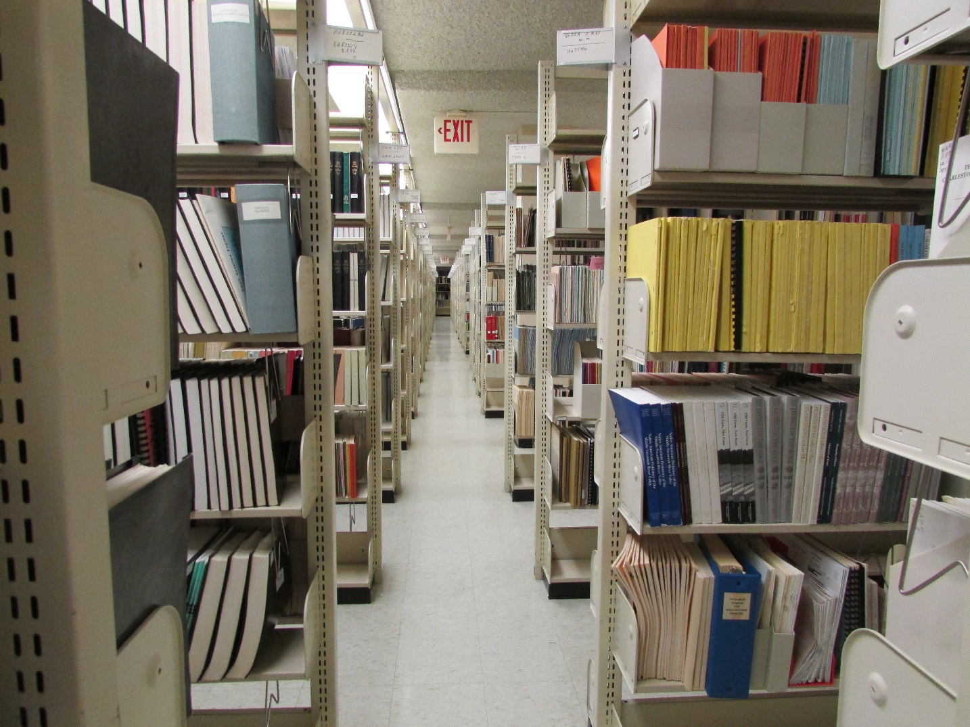
South Carolina State Documents Depository
The South Carolina State Library is the official state depository for all state publications. Our role is directed by the South Carolina Code of Laws, Title 60 - Chapter 2 - Sections 10, 20, and 30.

Slide 5
60-2-10, 20, 30
60-2-10. Definitions.
Defines “Complete depository”, “Depository system”, “Electronic”, “Print”, “Selective depository”, and “State publication”.
60-2-20. State library as official state depository of all state publications.
Main collection and distribution point, responsible for organizing, cataloging, and distributing.
60-2-30. State agencies, departments and state-supported institutions to provide copies od state publications; exceptions.
Provide 15 copies printed publications within 15 days; electronic copy within 15 days of posting. Waivers.
Source: Code of Laws of South Carolina 1976

Slide 6
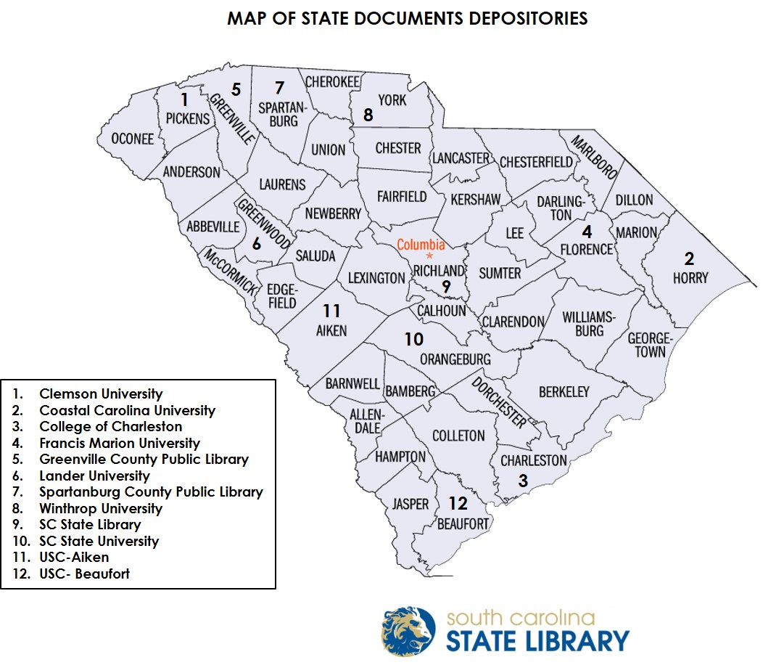
South Carolina State Documents Depository System
Depository System is comprised of SC State Library and 11 Depository Libraries:

Slide 7
What are State Documents?
For the purpose of the State Library, documents are defined as publications in print or electronic format issued by the State, agencies or departments, or state-supported colleges which are intended for public use or general distribution. State government documents include:
annual reports
agency newsletters
maps
research papers
books
public university catalogs
pamphlets, directories, magazines and many other items

Slide 8
Publications vs. Records: How to Identify
Publications are outward facing, published/created by agencies and intended for distribution to the public or General Assembly
SC Department of Archives and History collects agency records based on record retention schedules. Record series are identifiable types of records: legislative files, legal opinions, correspondence, etc. Every record series has a unique retention schedule found in the Archives Summary Guide to State Records . Record series and retention schedules are determined by a cooperative effort between the specific agency and the Archives.
Some overlap in that Archives also collects state publications. We do not collect internal agency records.

Slide 9
Why Do We Collect State Documents?
Legal, historical, and informational purposes
State law established a State Documents Depository with the South Carolina State Library as the Main Collection and Distribution Point
Documents provide a historical record of the agency, the work it does, and the employees who serve the State
Research purposes: meeting the information needs of government and government employees, other libraries, and the general public
To fulfil our mission to identify public documents, organize them, preserve them, and make them obtainable

Slide 10
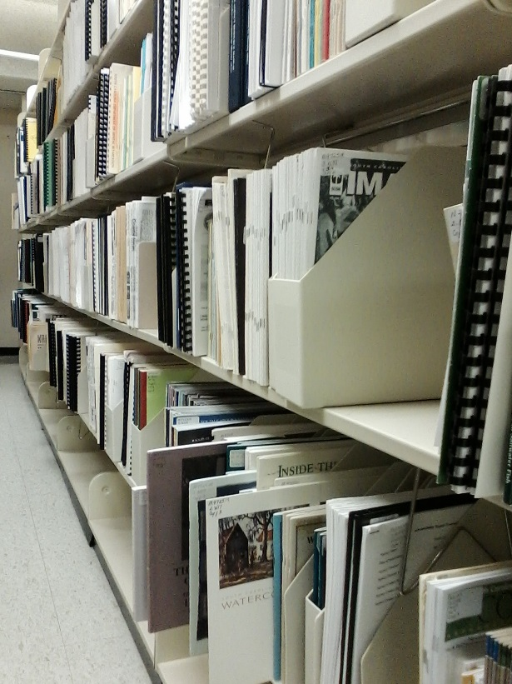
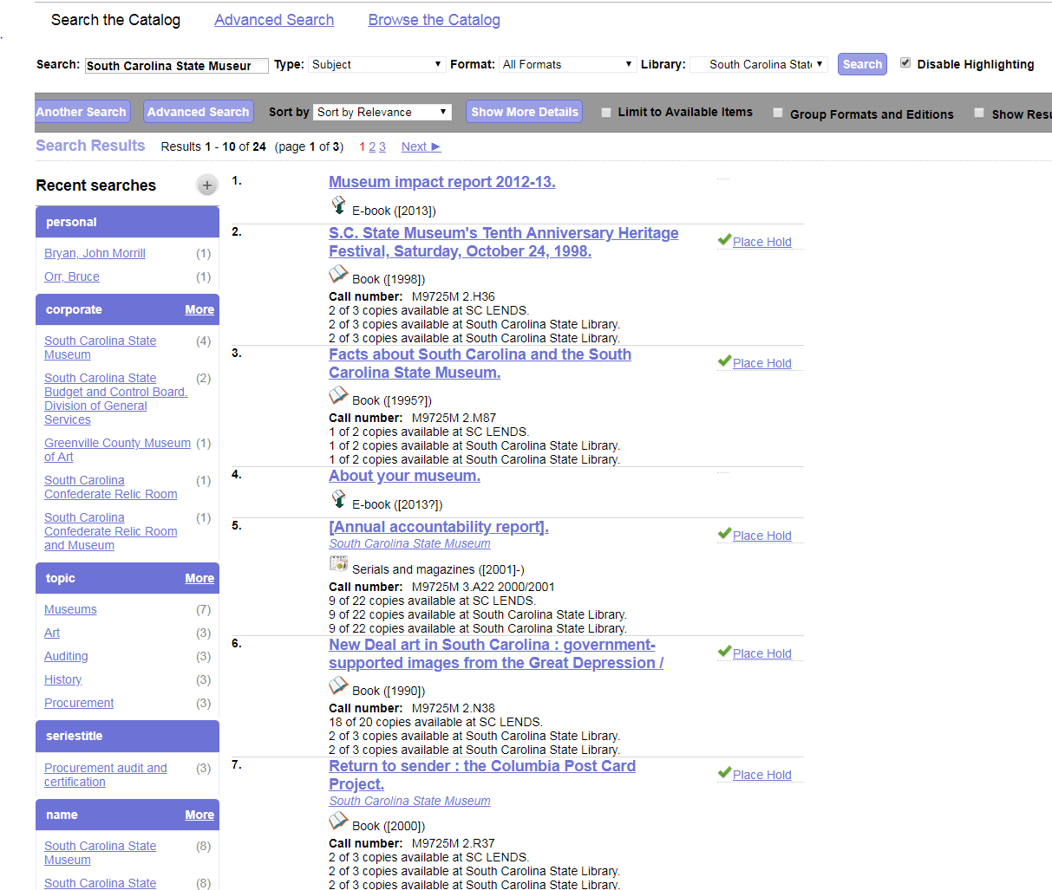
South Carolina State Documents Depository: Print and Digital Collections
Print collection can be searched online in SCLends.
Electronic documents can be found in Digital Collections.

Slide 11
Print Collection
Web address: sclends.org
Unique cataloging system created in 1970 and revised in 1982
Uses letters and numbers to create classification numbers based on the agency name, type of publication, geographic location, etc.
Over 100,000 documents cataloged
Request 15 copies of documents, 3 for the State Library, with other copies distributed to Depository System libraries and the Library of Congress
Copy 1 is never circulated, Copies 2 and 3 circulate, if available, post 1920

Slide 12
Digital Collection
Web address: dc.statelibrary.sc.gov
Includes:
State Documents Depository
Federal Documents
Book Collection
More…
Over 150 agencies, universities, and committees represented
Some agencies include sub-agencies, divisions, and offices
Over 27,500 documents currently available, and growing
Provides accessibility & preservation

Slide 13
How do We Obtain State Documents?
We order documents annually from the state legislature, search agency websites for publications, acquire documents mentioned in news reports, and subscribe to agency newsletters and e-mail lists.
Agencies routinely provide us with printed publications through mail, drop off, pick-up.
Agencies send electronic publications to our documents email: statedocuments@statelibrary.sc.gov
Archive-It web crawler.

Slide 14
When/How to Send Us Your Documents
When:
Yearly, quarterly, monthly, or anytime! Process is each agency’s decision.
Print items are sent out to 11 depository libraries quarterly
Digital items are shared with depository libraries monthly
How:
Ship/Deliver printed items to: 1500 Senate Street, Columbia, SC 29201
Email digital items to us in PDF format at: statedocuments@statelibrary.sc.gov
We can pick up printed items locally: (call or email us)

Slide 15
Exceptions to the “15 Copies” Rule
If printed, “all state agencies, departments, and state-supported colleges and universities must provide at least fifteen copies” unless:
Ephemera
Less than ten copies printed
Waiver
If publication is born-digital and printed, we request 3 copies for the for the State Library, unless:
Publication is of value to all depositories (request 15)
Limited printing budget (request 1)
Intended only for Committee (request electronic copy only)
For purchase publication (request 3)

Slide 16
If You Post It or Print It, We Get It!
If printed with intention to distribute: public documents, not internal procedures, guidelines, correspondence
15 printed copies, mail, pick-up, or drop off: 1500 Senate Street, Columbia, SC 29201
If you post on your web site (not social media, internal newsletter email, press releases, etc.)
PDF file to statedocuments@statelibrary.sc.gov
Electronic copies are distributed to depositories by us through email

Slide 17
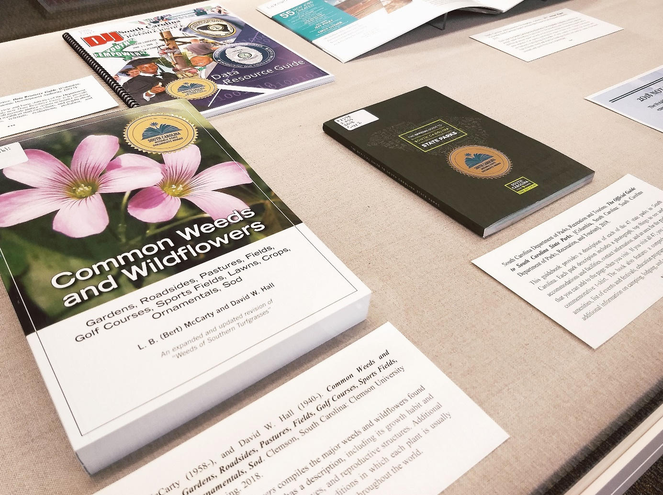
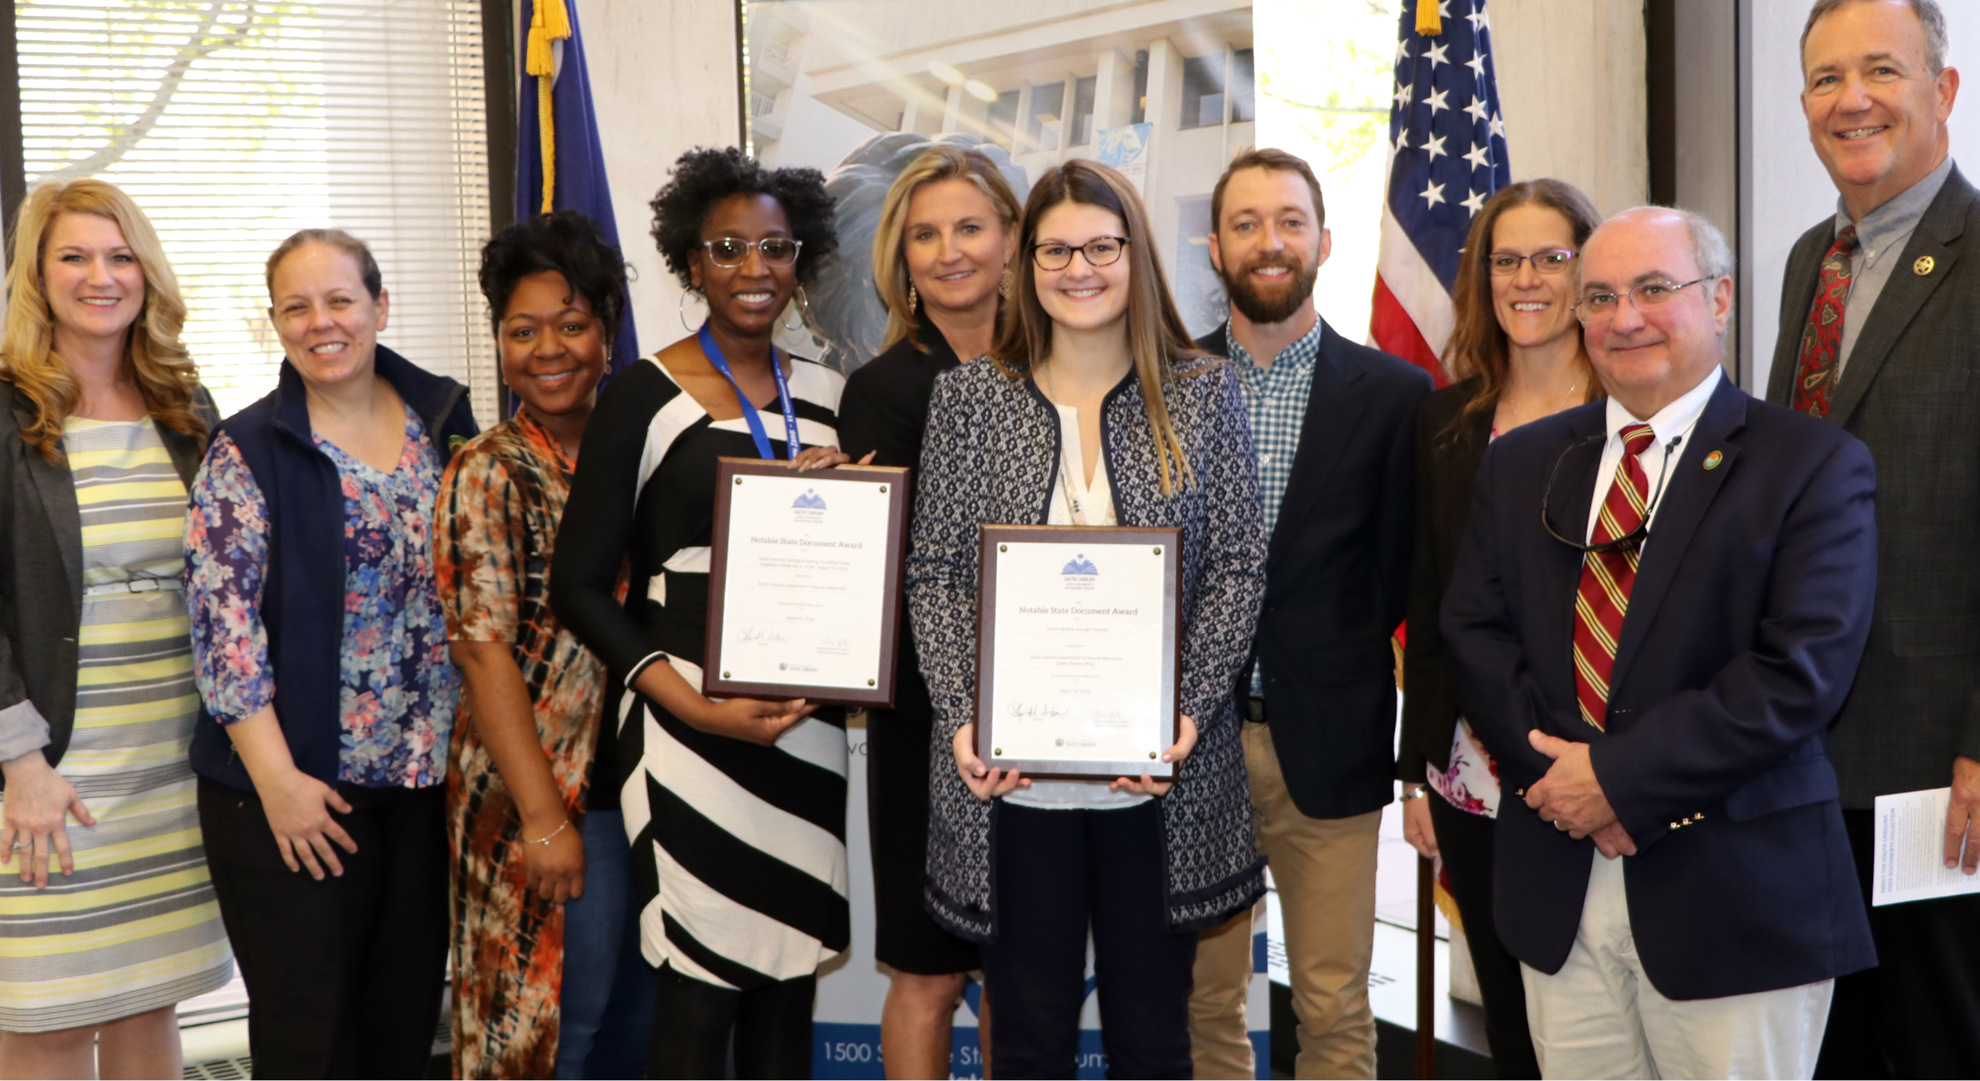
Notable State Documents Awards Program

Slide 18
Notable State Documents Awards Program
The Notable State Documents Awards Program began in 1991 to recognize exemplary state publications. Presented annually by the South Carolina State Documents Depository System, the awards recognize notable documents that were released in the previous calendar year. This year’s deadline is December 31 for publications produced during 2020.
In honor of Freedom of Information Day, awards are presented each March in a ceremony at the State Library.
South Carolina State Documents Depository LibGuide: Notable State Documents Awards Program

Slide 19
FAQs
Q: What e-formats do you accept?
A: At this time, we’re primarily adding publications that are in PDF format. We ask that if you have a publication in another format, such as a PowerPoint, you convert it into PDF for submission to the depository. We do sign up for agency e-newsletters because even though we don’t save in that format, articles may lead us to PDFs. We are also able to add publications in MP3 audio format, ex. PSAs. If you have a document in another format, please contact us.

Slide 20
FAQs
Q: What if the file is to large to send by email:
A: You have several options. First, just send us a title and link to the web page where the new publication can be found. The email can go either to me or, preferably, to statedocuments@statelibrary.sc.gov. You can also send by email in smaller batches of PDFs, at a size Outlook will handle. We can also accept publications by secure cloud-based file sharing products. Our IT department prefers ShareBase. With this product, we send a link and you upload the files to the file sharing site. Many agencies prefer to use their own file sharing service and will upload the files and send us a link. Last, you can place a large file or files on a flash drive and drop it off at the library. We’ll securely transfer the files and return your flash drive.

Slide 21
FAQs
Q: Do you accept past publications, either tangible or electronic?
A: Yes, both. If the physical publication is older than five years, please provide up to 3 copies, not fifteen. If the older publication is in electronic format only, please send just a PDF or link.
Q: How do I know if you have a specific publication from our agency?
A: Check for title in SC Lends (sclends.org) and/or SC State Documents Depository Digital Collection (dc.statelibrary.sc.gov).

Slide 22
FAQs
Q: Do you have a list of the documents you collect?
A: No, there is no standard or comprehensive list because documents are collected based on what an agency publishes; this varies year to year. The only consistent publications are required annual reports, serials, etc. I have a short list, but it’s easiest to go to your agency’s specific digital collections page to see examples of what we collect.
Q: What is the difference between a Records Officer and Publications Officer?
A: The term “Publications Officer” is an informal term created by us to use for our agency contacts list. Records Officer is the formal designation for the person who deals with agency records turned over to SCDAH by series and schedules.

Slide 23
Thank You!
Contact me:
Sheila Dorsey, Government Documents Librarian
sdorsey@statelibrary.sc.gov (803) 734-7065

